Slide 1


HAZMAN NAIM BIN AHSAN
24 AUGUST 2023

Slide 2

Outline
Executive Summary
Introduction
Methodology
Results
Conclusion
Appendix

Slide 3
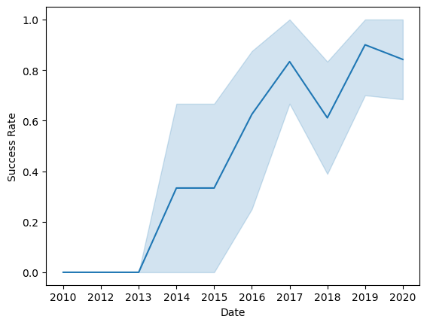

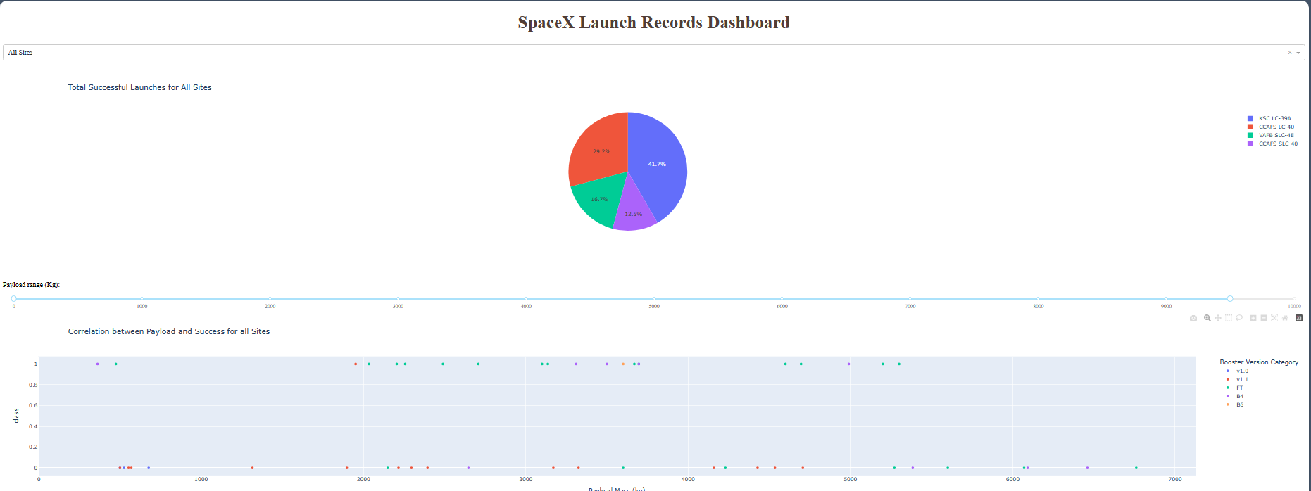
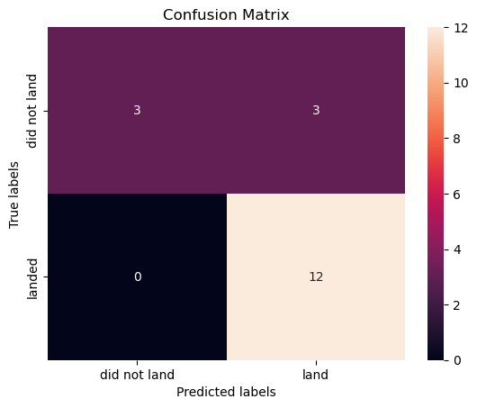
Executive Summary
1
2
Summary of methodologies
Data Collection
Data Wrangling
Exploratory Data Analysis
Interactive Visual Analytics
Predictive Analysis (Classification)
Summary of all results
Exploratory Data Analysis (EDA
Geospatial Analytics
Interactive Dashboard
Predictive Analysis of Classification Models
3
4

Slide 4
Introduction
This project aims to predict the success of Falcon 9 first stage landings, crucial due to SpaceX's cost-saving reusability, enabling accurate launch cost estimation and informed competition.
Can we predict Falcon 9 landing success accurately considering complex variables, ensuring reliable bid strategy for alternate launch companies?

Slide 5

Section 1

Slide 6
Methodology
Executive Summary
1. Data collection methodology
GET Request to SpaceX API
Web Scraping
2. Perform data wrangling
Handle missing values
Handle duplicates
Calculate the number of launches on each site
Calculate the number and occurrence of each orbit
Calculate the number and occurence of mission outcome per orbit type
Labelling the landing outcome
3. Perform exploratory data analysis (EDA) using visualization and SQL
Using SQL queries to examine the dataset
Using Pandas and Matplotlib to perform EDA and feature engineering
4. Perform interactive visual analytics using Folium and Plotly Dash
Geospatial analytics using Folium
Building dashboard using Plotly Dash
5. Perform predictive analysis using classification model
Building classification models: Logistic regression, Support vector classifier, Decision tree classifier, KNN
Calculating accuracy score for each models and visualized with confusion matrix

Slide 7
Data Collection – SpaceX API
Obtaining launch data through the SpaceX API, which includes details about the rocket utilized, the payload dispatched, launch and landing specifications, as well as the outcome of the landing.
Make a GET response to the SpaceX REST API
Convert the response to a .json file then to a Pandas DataFrame
Use custom logic to clean the data
Define lists for data to be stored in
Call custom functions to retrieve data and fill the lists
Use these lists as values in a dictionary and construct the dataset
Create a Pandas DataFrame from the constructed dictionary dataset
Filter the DataFrame to only include Falcon 9 launches Reset the FlightNumber column Replace missing values of PayloadMass with the mean PayloadMass value
Github Link

Slide 8
Data Collection – Web Scraping
Gathering historical launch records of Falcon 9 from a Wikipedia page named "List of Falcon 9 and Falcon Heavy launches" through web scraping.
Request the HTML page from the static URL Assign the response to an objectt
Create a BeautifulSoup object from the HTML response object Find all tables within the HTML page
Collect all column header names from the tables found within the HTML page
Use the column names as keys in a dictionary Use custom functions and logic to parse all launch to fill the dictionary values
Convert the dictionary to a Pandas DataFrame ready for export
Github Link

Slide 9
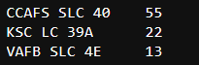

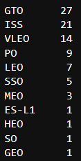
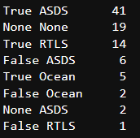
Data Wrangling
In this section, the initial exploration and analysis of the dataset aim to provide insights into SpaceX launches. The dataset includes various columns, each offering valuable information about the launches. Let's examine the key insights extracted:
Number of Launches per Site
Distribution of Launch Orbits
Mission Outcomes
Creating Landing Outcome Labels (1=Success, 0=Failed)
1
4
2
3
Github Link

Slide 10
EDA with Data Visualization
In the EDA - Visualizations section, several types of charts were utilized to analyze and present the data.
Scatter Chart
Flight Number and Launch Site
Bar Chart
Success Rate and Orbit Type
Line Chart
Success Rate and Year (i.e. the launch success yearly trend)
Payload and Launch Site
Orbit Type and Flight Number
Payload and Orbit Type
Scatter charts are useful to observe relationships, or correlations, between two numeric variables.
Bar charts are used to compare a numerical value to a categorical variable. Horizontal or vertical bar charts can be used, depending on the size of the data.
Line charts contain numerical values on both axes, and are generally used to show the change of a variable over time.
Github Link

Slide 11
EDA with SQL
In the EDA - SQL section, the following analyses were conducted:
The names of the unique launch sites in the space mission were displayed.
Five records where launch sites began with the string 'CCA' were displayed.
The total payload mass carried by boosters launched by NASA (CRS) was calculated and displayed.
The average payload mass carried by the booster version F9 v1.1 was computed and displayed.
The date when the first successful landing outcome on a ground pad was achieved was listed.
The names of the boosters which had success on a drone ship and a payload mass between 4000 and 6000 kg were listed.
The total number of successful and failed mission outcomes were calculated and listed.
The names of the booster versions which have carried the maximum payload mass were listed.
The failed landing outcomes on drone ships, their booster versions, and launch site names for 2015 were listed.
The count of landing outcomes (such as Failure (drone ship) or Success (ground pad)) between the date 2010-06-04 and 2017-03-20, were ranked in descending order.
Github Link

Slide 12
Build an Interactive Map with Folium
In the Interactive Map with Folium section, the following steps were executed:
Marking Launch Sites:
All launch sites were marked on a map.
This was achieved by initializing a map using a Folium Map object.
A folium.Circle and folium.Marker were added for each launch site on the launch map.
Marking Launch Outcomes:
The success and failure of launches for each site were marked on a map.
Given that many launches share the same coordinates, they were clustered together for better visualization.
The color of the markers was set to green for successful launches and red for failed ones.
Each launch was added to a MarkerCluster() object with an icon as a text label, and the icon_color was set based on the marker color determined previously.
Calculating Distances:
The distances between a launch site and its proximities were calculated using the latitude and longitude values.
A point was marked using these values, and a folium.Marker object was created to display the distance.
A folium.PolyLine was drawn to display the distance line between two points and added to the map.
Github Link

Slide 13
Build a Dashboard with Plotly Dash
Interactive visualizations of the data were created using a Plotly Dash dashboard. The following plots were included:
Pie Chart:
A pie chart was created using px.pie() to display the total successful launches per site.
This visualization made it clear which sites had the most successful launches.
A filter was added using a dcc.Dropdown() object to view the success/failure ratio for individual sites.
Scatter Graph:
A scatter graph was created using px.scatter() to show the correlation between outcome (success or not) and payload mass (kg).
A filter was added using a RangeSlider() object to view data within specific ranges of payload masses.
Github Link

Slide 14
Predictive Analysis - Classification
Model Development
The dataset was loaded and prepared for model development.
Appropriate machine learning algorithms were selected.
For each chosen algorithm:
Finding the Best Classification Model
The accuracy scores for all chosen algorithms were reviewed.
Necessary data transformations were performed to standardize and pre-process the data.
The data was split into training and test datasets using train_test_split().
For each chosen algorithm:
A GridSearchCV object and a dictionary of parameters were created.
The object was fitted to the parameters.
The training dataset was used to train the model.
Model Evaluation
The tuned hyperparameters (best_params_) were checked.
The accuracy (score and best_score_) was checked.
The Confusion Matrix was plotted and examined.
The model with the highest accuracy score was determined as the best performing model.
Github Link

Slide 15

Section 2

Slide 16
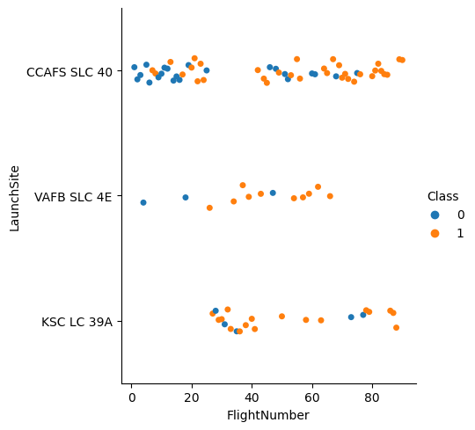
Flight Number vs. Launch Site
The scatter plot illustrating the relationship between Launch Site and Flight Number reveals several insights:
There is a positive correlation between the number of flights and the success rate at a launch site. As the flight count increases, so does the success rate.
The majority of initial flights (those with flight numbers less than 30) were launched from CCAFS SLC 40, and these generally did not succeed.
A similar trend is observed with flights from VAFB SLC 4E, where earlier flights experienced less success.
KSC LC 39A did not host any early flights, resulting in a higher success rate for launches from this site.
For flights with a number greater than approximately 30, there is a noticeable increase in successful landings (Class = 1).

Slide 17
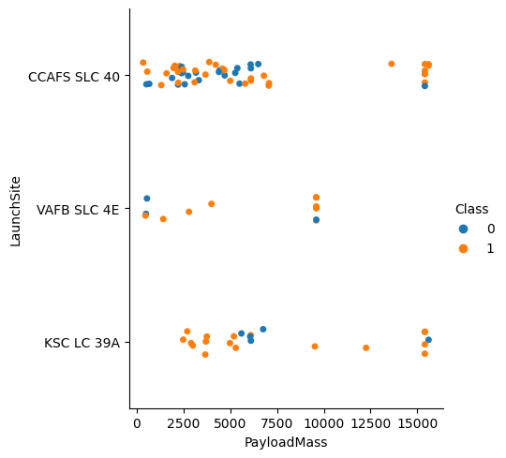
Payload vs. Launch Site
The scatter plot depicting the relationship between Launch Site and Payload Mass provides several key observations:
For payload masses exceeding approximately 7000 kg, unsuccessful landings are quite rare. However, it’s important to note that there is less data available for these heavier launches.
There doesn’t appear to be a distinct correlation between payload mass and success rate for a specific launch site.
All sites have launched a range of payload masses. Notably, most of the launches from CCAFS SLC 40 carried comparatively lighter payloads, although there were some exceptions.

Slide 18
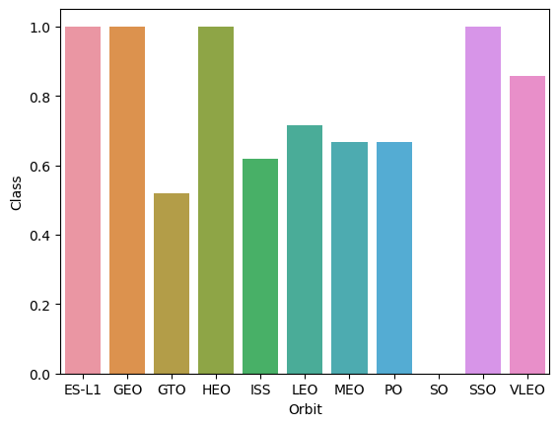
Success Rate vs. Orbit Type
The bar chart illustrating Success Rate versus Orbit Type reveals that the following orbits have achieved a perfect success rate of 100%:
ES-L1 (Earth-Sun First Lagrangian Point)
GEO (Geostationary Orbit)
HEO (High Earth Orbit)
SSO (Sun-synchronous Orbit)
On the other hand, the orbit with the lowest success rate, specifically 0%, is:
SO (Heliocentric Orbit)
This analysis provides valuable insights into the success rates associated with different orbit types.

Slide 19
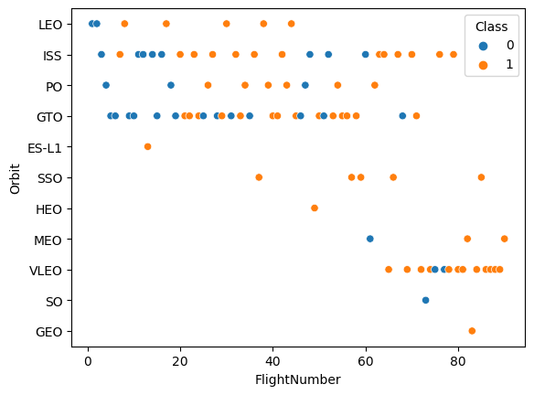
Flight Number vs. Orbit Type
The scatter plot comparing Orbit Type and Flight Number offers several unique insights:
The 100% success rate of GEO, HEO, and ES-L1 orbits can be attributed to the fact that there has only been one flight into each of these respective orbits.
The 100% success rate in SSO is particularly noteworthy, given that it encompasses five successful flights.
There appears to be little correlation between Flight Number and Success Rate for GTO.
Generally, an increase in Flight Number corresponds to an increase in the success rate. This trend is most pronounced for LEO, where unsuccessful landings predominantly occurred during the early launches with lower flight numbers.

Slide 20
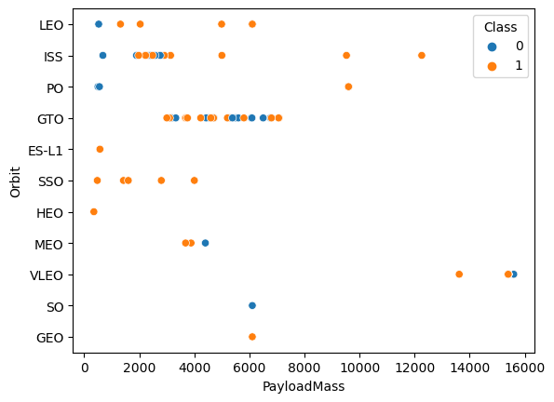
Payload vs. Orbit Type
The scatter plot comparing Orbit Type and Payload Mass reveals several key observations:
Certain orbit types, such as PO (Polar Orbit), ISS (International Space Station), and LEO (Low Earth Orbit), tend to have more successful launches with heavier payloads. However, it’s worth noting that the number of data points for PO is relatively small.
For GTO (Geostationary Transfer Orbit), the relationship between payload mass and success rate is not clearly defined.
Launches into VLEO (Very Low Earth Orbit) are typically associated with heavier payloads, which aligns with intuitive expectations.

Slide 21
Launch Success Yearly Trend
The line chart depicting the yearly average success rate provides several key insights:
From 2010 to 2013, all landings were unsuccessful, as indicated by a success rate of 0%.
Following 2013, there was a general upward trend in the success rate, despite minor dips observed in 2018 and 2020.
Post-2016, the chance of a successful landing was consistently above 50%.
This analysis highlights the significant improvements in landing success rates over time.

Slide 22
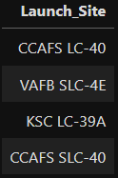
All Launch Site Names
Display the names of the unique launch sites in the space mission:
Use DISTINCT to select only unique values from the table.
Result:

Slide 23
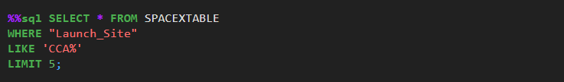
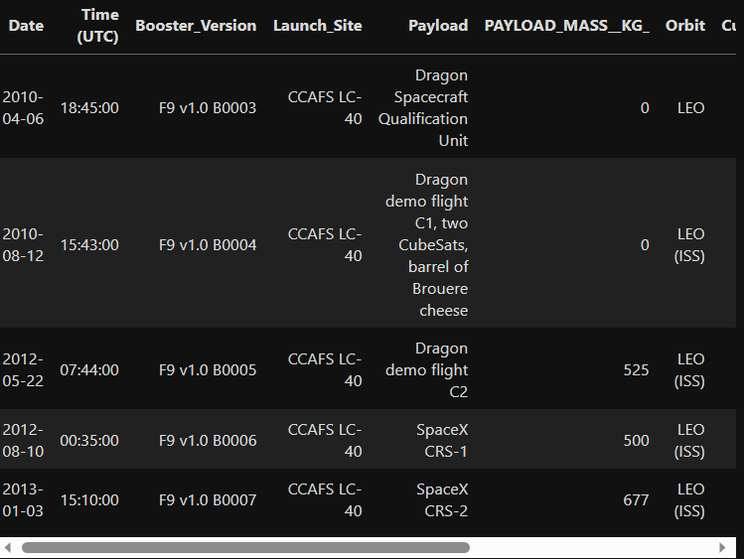
Launch Site Names Begin with 'CCA'
Display 5 records where launch sites begin with the string 'CCA'
LIMIT 5 fetches only 5 records, and the LIKE keyword is used with the wild card ‘CCA%’ to retrieve string values beginning with ‘CCA’.
Result:

Slide 24
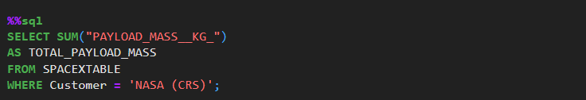
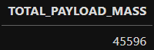
Total Payload Mass
Display the total payload mass carried by boosters launched by NASA (CRS)
The SUM keyword is used to calculate the total of the LAUNCH column, and the SUM keyword (and the associated condition) filters the results to only boosters from NASA (CRS).
Result:

Slide 25
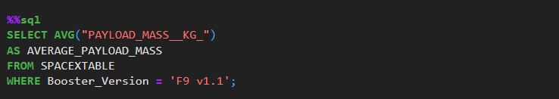
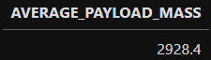
Average Payload Mass by F9 v1.1
Display average payload mass carried by booster version F9 v1.1
The AVG keyword is used to calculate the average of the PAYLOAD_MASS__KG_ column, and the WHERE keyword (and the associated condition) filters the results to only the F9 v1.1 booster version.
Result:

Slide 26
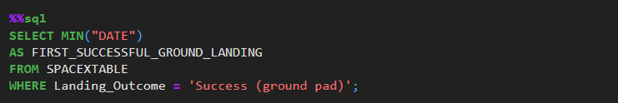

First Successful Ground Landing Date
List the date when the first succesful landing outcome in ground pad was acheived.
The MIN keyword is used to calculate the minimum of the DATE column, i.e. the first date, and the WHERE keyword (and the associated condition) filters the results to only the successful ground pad landings.
Result:

Slide 27
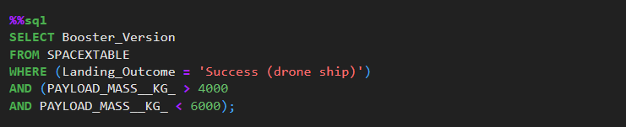
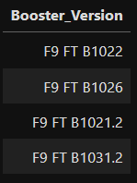
Successful Drone Ship Landing with Payload between 4000 and 6000
List the names of the boosters which have success in drone ship and have payload mass greater than 4000 but less than 6000
The WHERE keyword is used to filter the results to include only those that satisfy both conditions in the brackets (as the AND keyword is also used). The BETWEEN keyword allows for 4000 < x < 6000 values to be selected.
Result:

Slide 28
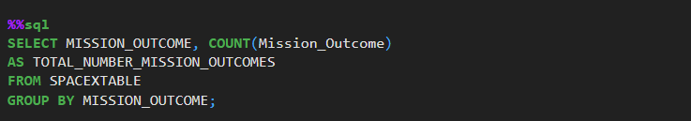
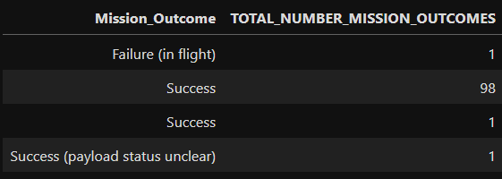
Total Number of Successful and Failure Mission Outcomes
List the total number of successful and failure mission outcomes
The COUNT keyword is used to calculate the total number of mission outcomes, and the GROUPBY keyword is also used to group these results by the type of mission outcome.
Result:

Slide 29
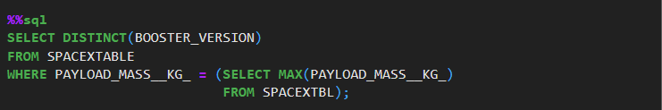
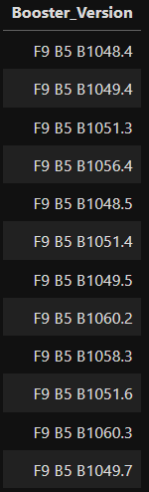
Boosters Carried Maximum Payload
List the names of the booster_versions which have carried the maximum payload mass.
Result:
A subquery is used here. The SELECT statement within the brackets finds the maximum payload, and this value is used in the WHERE condition. The DISTINCT keyword is then used to retrieve only distinct /unique booster versions.

Slide 30
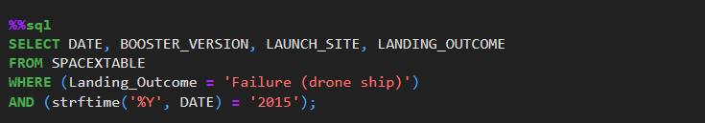
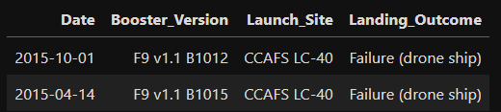
2015 Launch Records
List the records which will display the month names, failure landing_outcomes in drone ship, booster versions, launch_site for the months in year 2015.
The WHERE keyword is used to filter the results for only failed landing outcomes, AND only for the year of 2015.
Result:

Slide 31
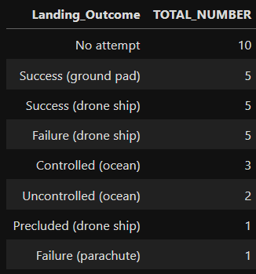
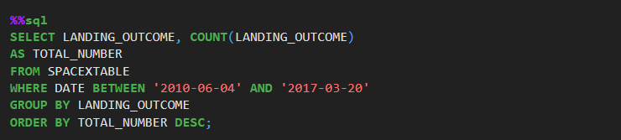
Rank Landing Outcomes Between 2010-06-04 and 2017-03-20
Rank the count of landing outcomes (such as Failure (drone ship) or Success (ground pad)) between the date 2010-06-04 and 2017-03-20, in descending order.
Result:
The WHERE keyword is used with the BETWEEN keyword to filter the results to dates only within those specified. The results are then grouped and ordered, using the keywords GROUP BY and ORDER BY, respectively, where DESC is used to specify the descending order.

Slide 32

Section 3

Slide 33
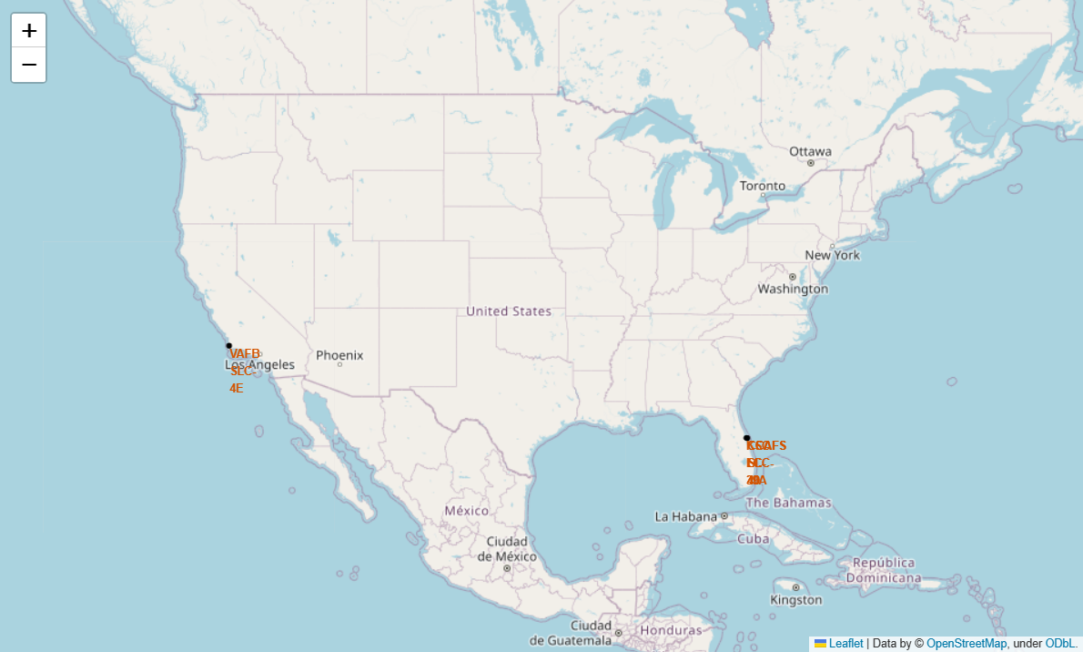
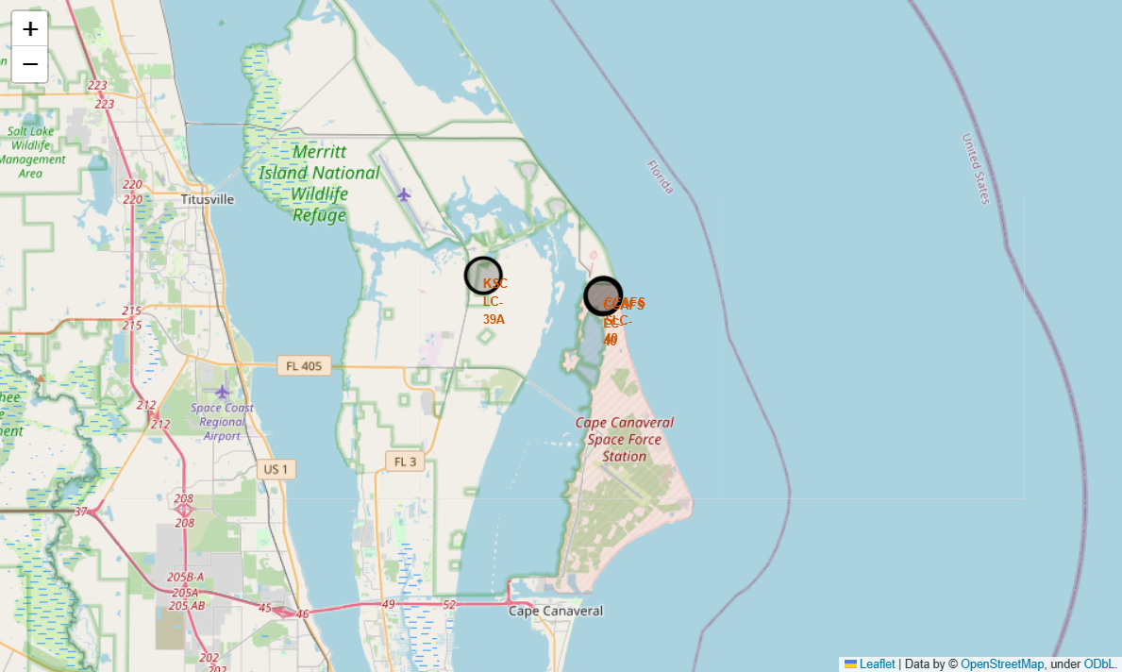
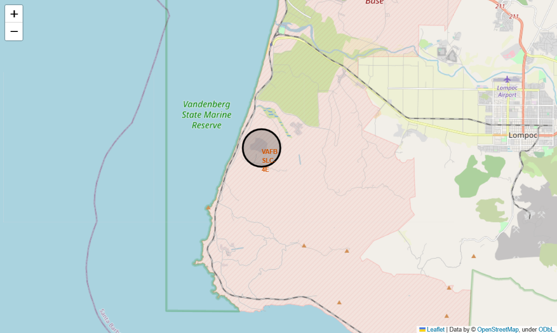
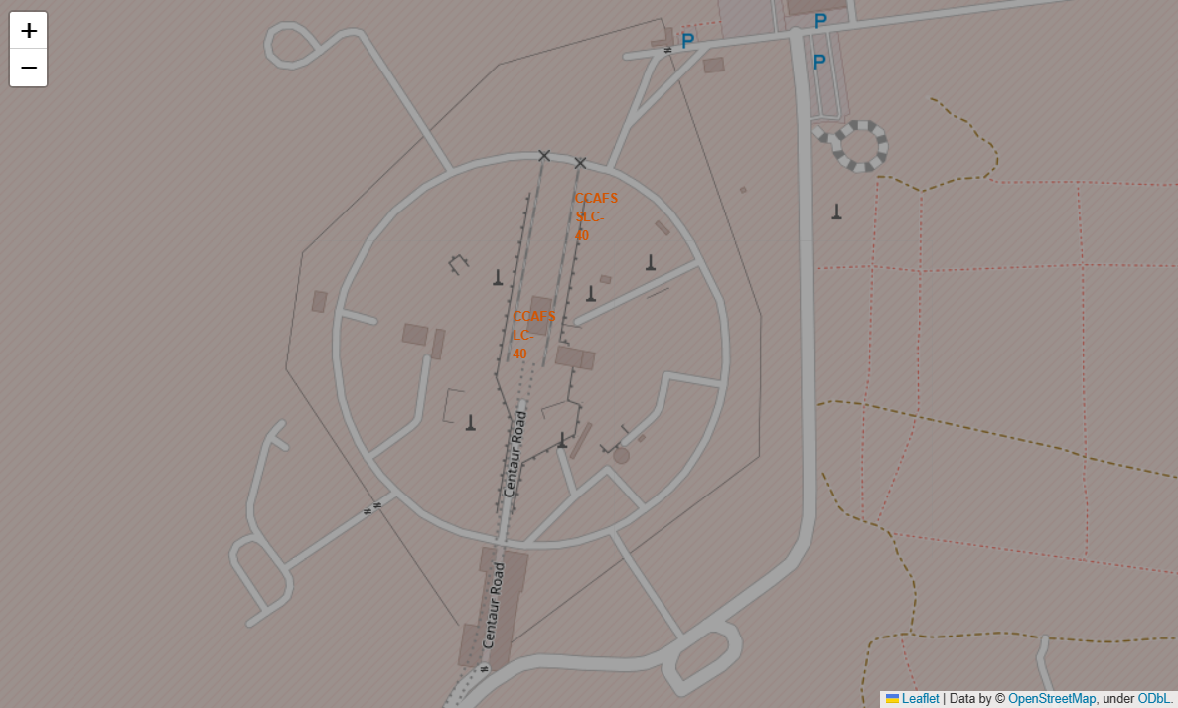
All Launch Sites
KSC LC-39A
(28.573255 , -80.646895)
CCAFS SLC-40
(28.563197 , -80.576820)
VAFB SLC-4E
(34.632834 , -120.610745)
CCAFS LC-40
(28.562302 , -80.577356)

Slide 34
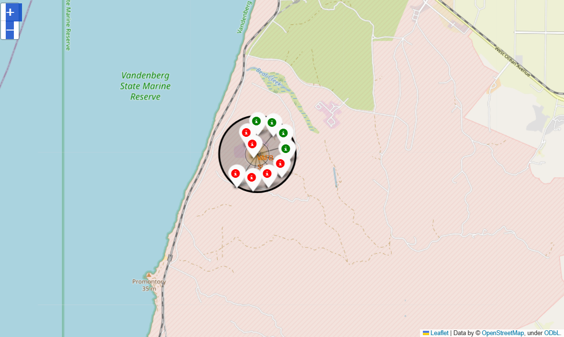
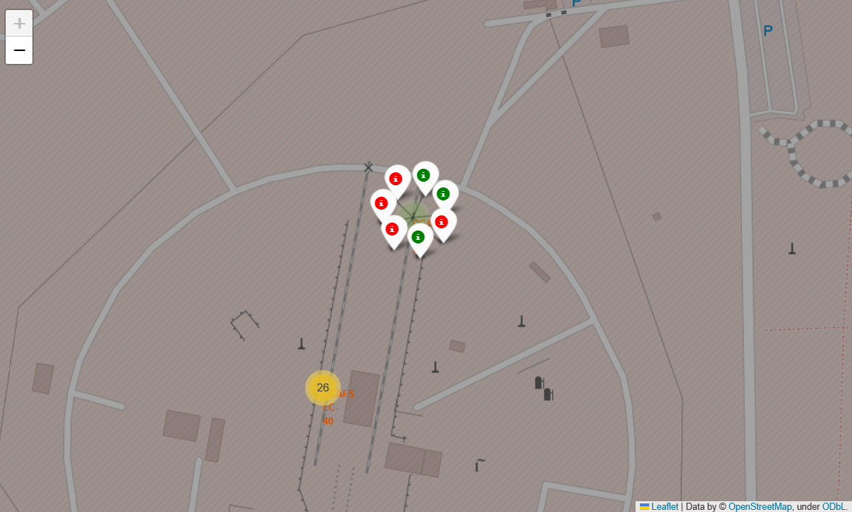
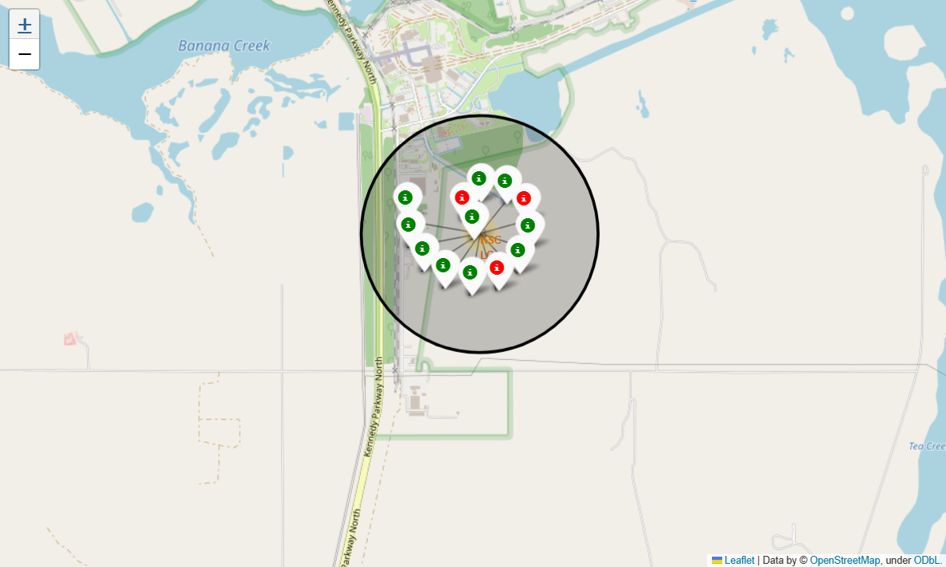
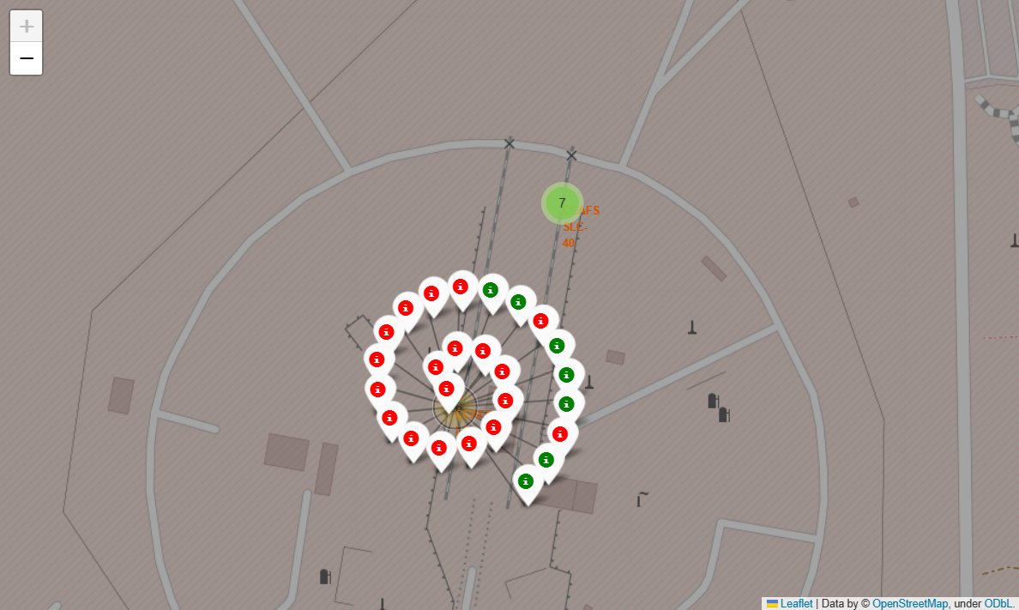
Success Status For Each Launch Site
VAFB SLC-4E
CCAFS SLC-40
KSC LC-39A
CCAFS LC-40

Slide 35
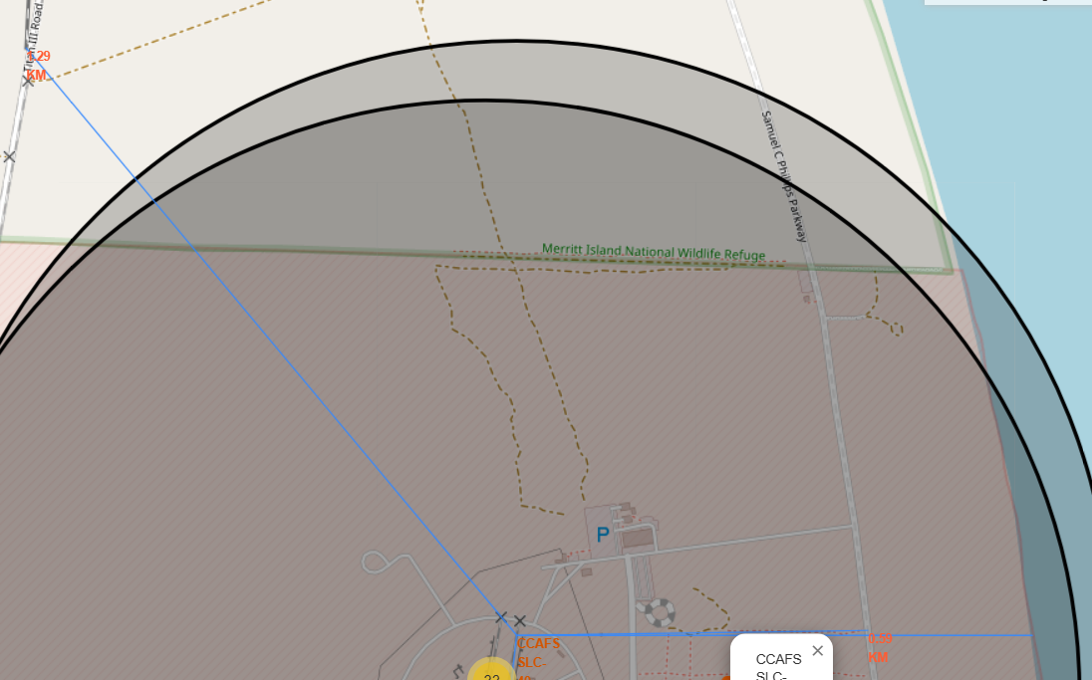
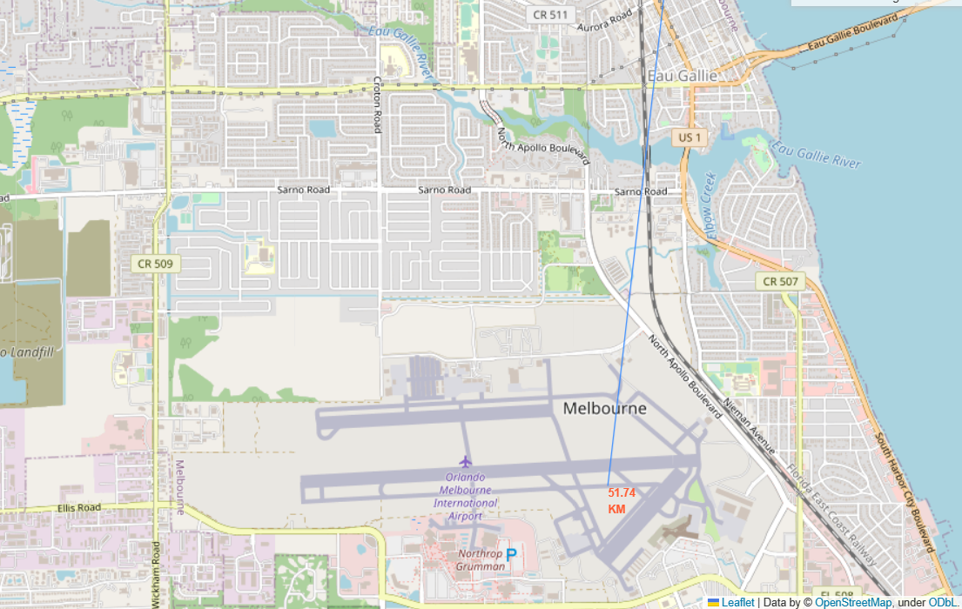
Points Of Interest Proximity
For CCAFS SLC-40 :
Nearest Railway : 1.29 km
Nearest Highway: 0.59 km
Nearest Coastline: 0.87 km
Nearest Airport: 51.74 km

Slide 36

Section 4

Slide 37
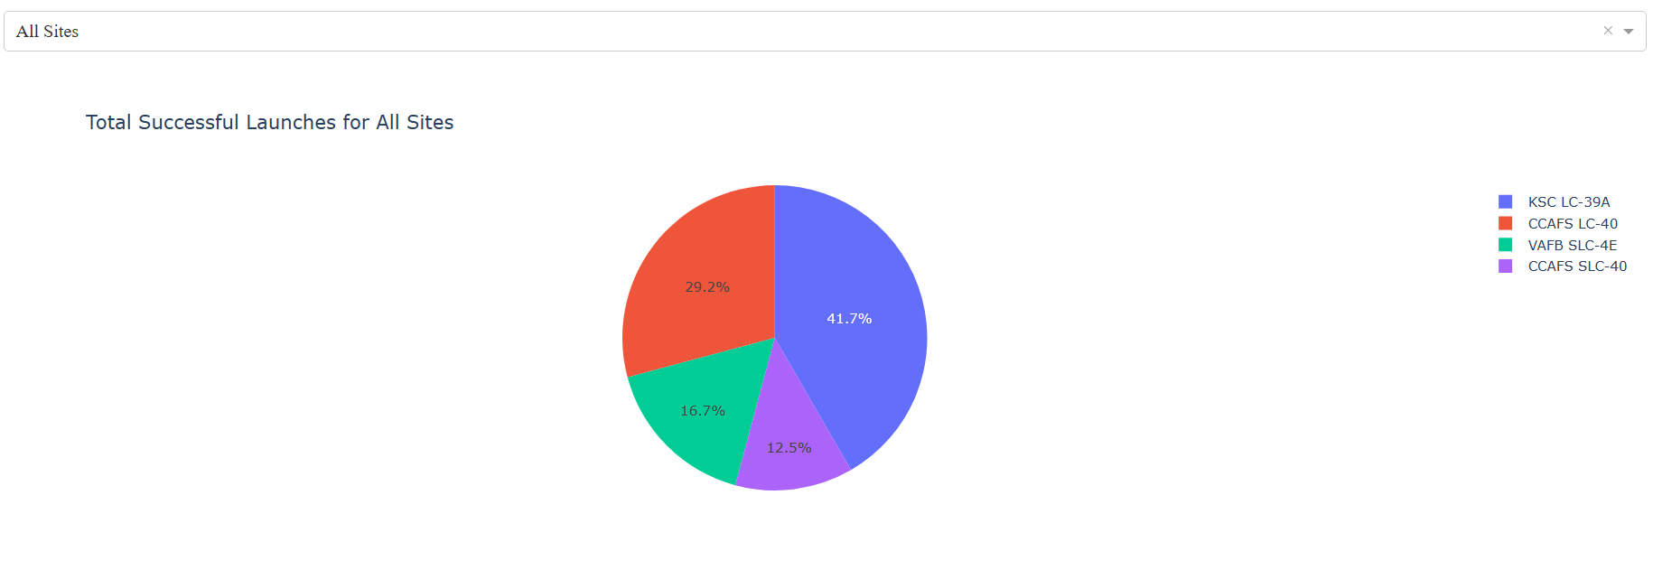
Successful Launcher for All Sites
The launch site KSC LC-39A had the most successful launches, with 41.7% of the total successful launches while the launch site CCAFS SLC-40 had the least successful launcher with 12.5% of the total successful launches.

Slide 38
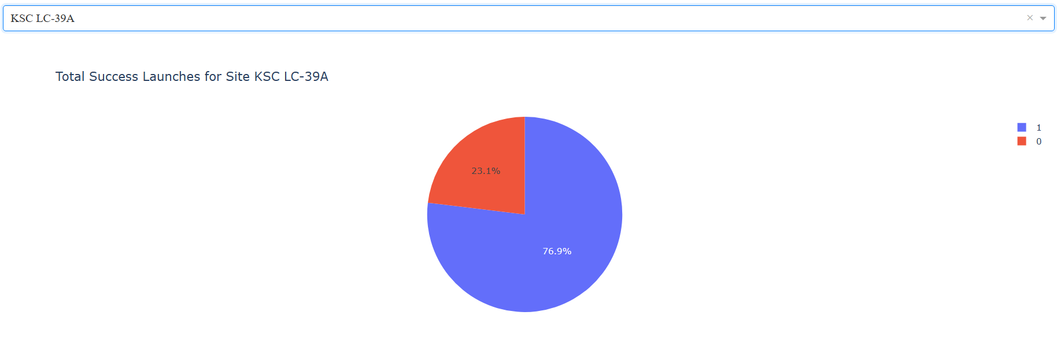
Launch Site with Highest Success Ratio
The launch site KSC LC-39A had the highest success launch ratio, with 76.9% of the total launches are successful.

Slide 39
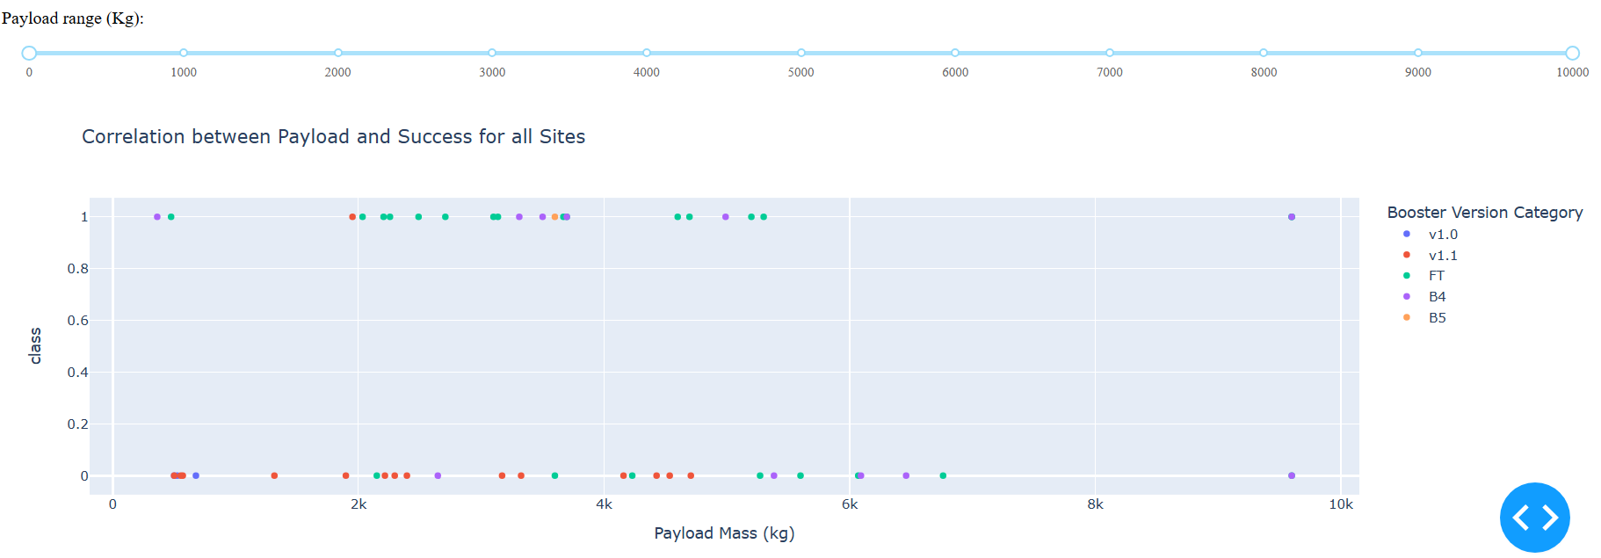
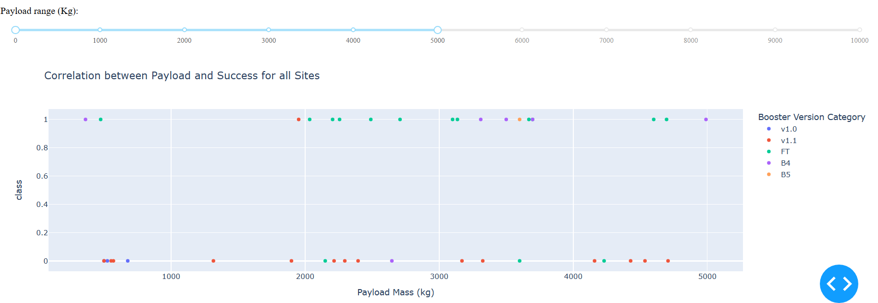
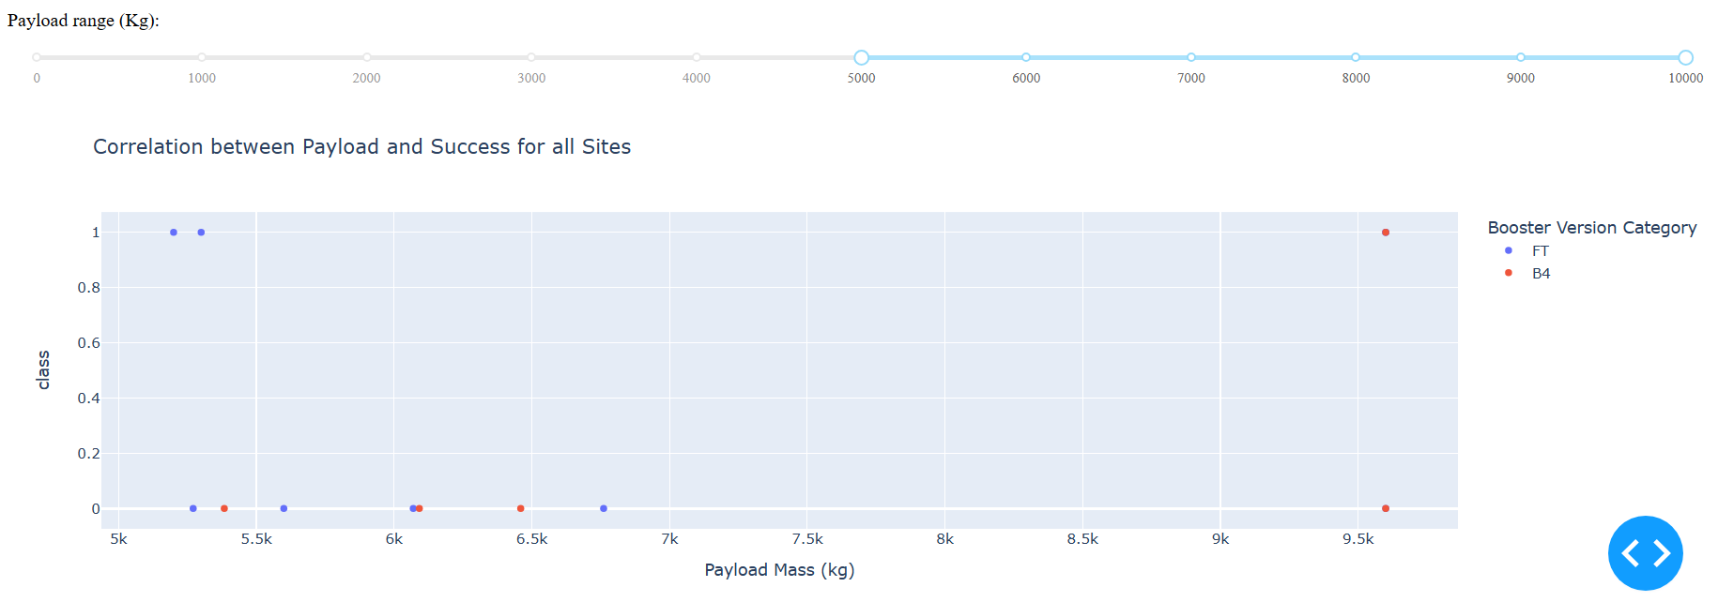
Launch Outcome VS. Payload Scatter Plot
There is a gap around 4000 kg when plotting the launch outcome against the payload for all sites.
The data can be divided into two ranges: low payloads (0-4000 kg) and massive payloads (4000-10000 kg).
The success rate for massive payloads is lower than that for low payloads.
Some booster types, such as v1.0, v1.1 and B5, have not been used to launch massive payloads.
Low Payloads
Massive Payloads
Low Payloads
Massive Payloads

Slide 40

Section 5

Slide 41
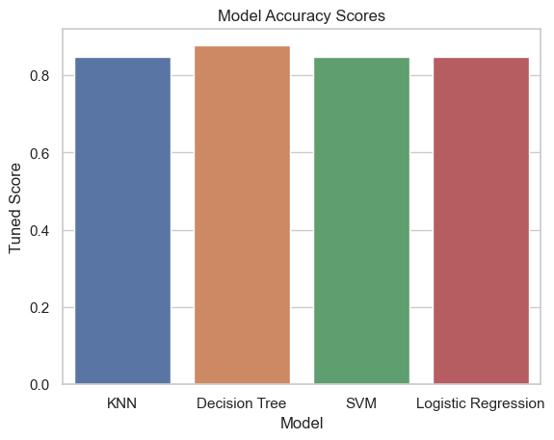
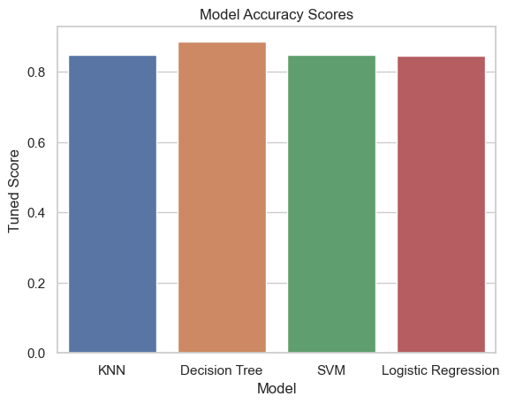
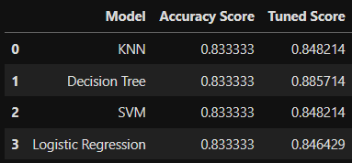
Classification Accuracy
Four classification models have been created: KNN, Decision Tree, SVM, and Logistic Regression.
The Decision Tree model is the most accurate, with a tuned accuracy score of 88.6%.

Slide 42
Confusion Matrix
The Decision Tree model is the most accurate, with a tuned accuracy score of 88.6%.
The confusion matrix on the left shows that out of a total of 18 launches, only 3 were misclassified while the remaining 15 were correctly classified.

Slide 43
Conclusions
The success rate at a launch site increases as the number of flights increases, with most early flights being unsuccessful. This suggests that with more experience, the success rate increases.
Between 2010 and 2013, all landings were unsuccessful, as indicated by a success rate of 0%.
After 2013, the success rate generally increased, despite experiencing small dips in 2018 and 2020.
After 2016, there was always a greater than 50% chance of success.
Orbit types ES-L1, GEO, HEO, and SSO have the highest success rate at 100%. The 100% success rate of GEO, HEO, and ES-L1 orbits can be attributed to the fact that there was only one flight into each of these respective orbits. The 100% success rate in SSO is particularly impressive, with 5 successful flights.
The orbit types PO, ISS, and LEO have more success with heavy payloads. VLEO (Very Low Earth Orbit) launches are associated with heavier payloads, which is intuitively understandable.
The launch site KSC LC-39A had the most successful launches, accounting for 41.7% of the total successful launches. It also had the highest rate of successful launches at 76.9%.
The success rate for massive payloads (over 4000kg) is lower than that for low payloads.
The best performing classification model is the Decision Tree model, with an accuracy of 88.6%.

Slide 44
Appendix
Relevant Python Libraries:
Matplotlib
Numpy
Seaborn
Plotly
Dash
Scikit-Learn
Folium
Do check the Github links provided in each section for the source code.

Slide 45


